Slide 1
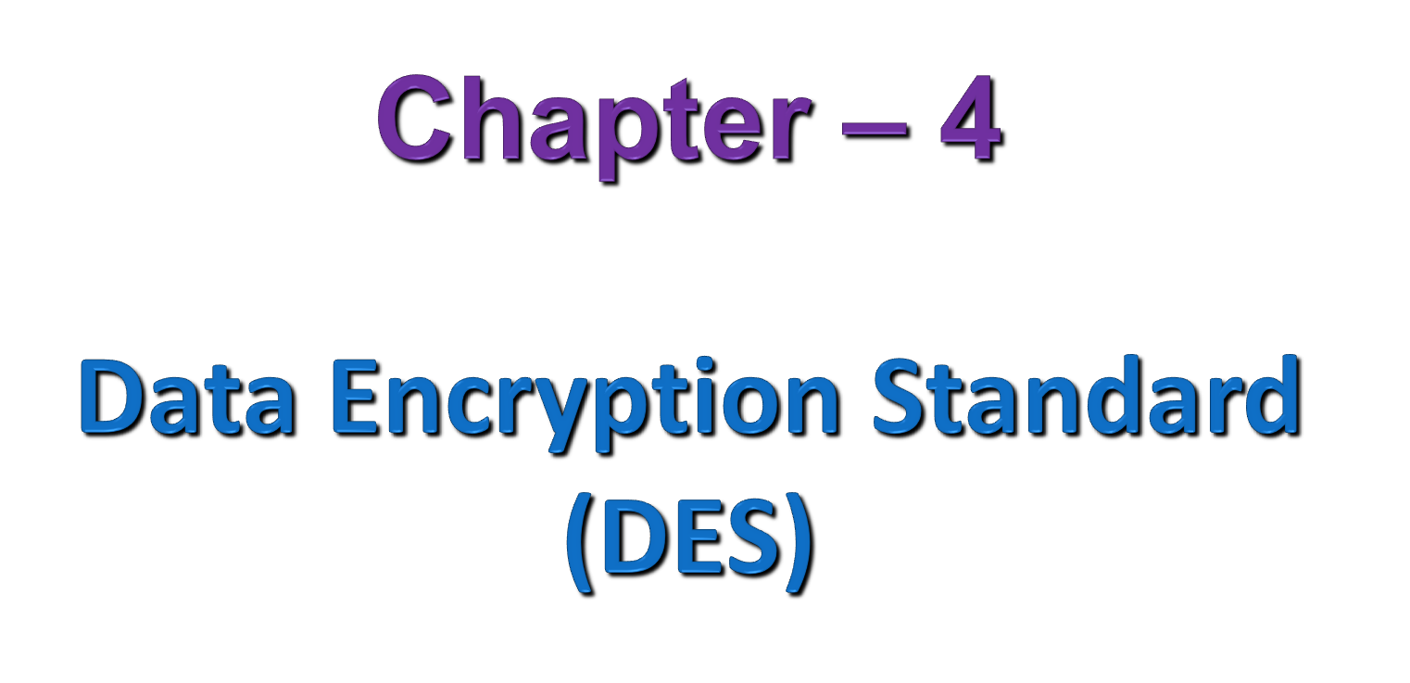
Notes:
SCA3103 - Introduction to Multimedia
Semester 2 - 02/03
Lecture 1

Slide 2
Outline
Introduction
Feistel Cipher Structure
The Data Encryption Standard (DES)
DES Analysis
The strength of DES
Multiple Encryption With DES
Differential and Linear Cryptanalysis

Slide 3
1. Introduction to DES
DES was published by US National Bureau of Standards (NBS) in 1977 which was the predecessor of the US National Institute of Standards and Technology (NIST).
DES was based on the Lucifer encryption algorithm developed by an IBM research group led by Horst Feistel.
DES was widely used from mid-1970‘s to early-2000's.
Although gradually phasing out, DES played an important role in modern cryptography and represents a popular design paradigm for data encryption.
DES’s encryption and decryption structures are symmetrical, and they use 4 basic operations: exclusive-OR, permutation, substitution, and circular shift.

Slide 4
Cont . . .
Exclusive-OR,
    X ⊕ 0^{n} = X, X ⊕ X = 0^{n}, X ⊕ Y=Y ⊕ X
Permutation (Transposition)
    No elements are added/deleted/replaced in the sequence, rather order in which elements appear in the sequence is changed
Substitution
    Each plaintext element/group of elements is uniquely replaced by corresponding ciphertext element or group of elements
Circular shift
    It shifts each bit in an n-bit word K positions to the left and the leftmost k bits become the original rightmost bits.

Slide 5
Cont . . .
Goals of DES
  If frequency distribution of the various letters or words or phrases are in any way reflected in the ciphertext, the cryptanalyst may be able to deduce the encryption key, part of the key, or at least a set of keys likely to contain the exact key.
  Diffusion
      Seeks to make the statistical relationship between the plaintext and ciphertext as complex as possible in order to thwart attempts to deduce the key
  Confusion
      Seeks to make relationship between the statistics of ciphertext and the value of encryption key as complex as possible.

Slide 6
Feistel Cipher Structure (FCS)
The inputs to the encryption algorithm are a plaintext block of length 2l bits and a key K .
Plaintext block is divided into two halves, LE₀ and RE₀
FCS only uses basic operations of
      XOR and
      Substitution
The two halves of the data pass through n rounds of processing and then combine to produce the ciphertext block.
Each round i has as inputs LE_{i-1} and RE_{i-1} derived from the previous round, as well as a subkey K_{i} derived from the overall K.
In general, the subkeys K_{i} are different from K and from each other

Slide 7
Cont . . .
Algorithm Description
  Elements of FCS
      Plaintext
      Secret key and subkeys
      Substitution Function
      XOR operations
      Round number
  Assume
      n be a positive integer
      F denote substitution function
      K denotes the encryption key

Slide 8
Cont . . .
Algorithm Description
  Step 1: FCS first generates n subkeys of a fixed length from the encryption key K. Let these subkeys be K_{l},K₂, . . . . ,K_{n}
  Step 2: Divide a 2l-bit plaintext block M into two halves LE₀ and RE₀ of equal length, where LE₀ and RE₀, respectively, the prefix substring and the suffix substring of M.
  Step 3: a substitution function F, takes an l-bit suffix substring (RE_{i} where i = 1, 2, …. n) of M and a subkey as Input, and generates an l-bit binary sting as output
  Step 4: Making XOR of the output of substitution function and the left half of the data (LE_{i} where i = 1, 2, …. n)

Slide 9

Cont . . .
Algorithm Description
  Step 5: increment i and LE_{i} = RE_{i-1} and RE_{i} = Output of step 4
  Step 6: Repeat step 3 through step 5 until round is over (n times)
  Step 7: interchange of the two halves of the data of final round (permutation)
After n rounds, the plaintext block M = LE₀RE₀ is transformed to C = LE_{n}RE_{n}

Slide 10
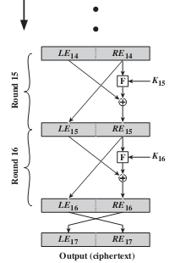
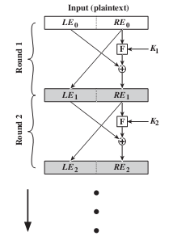
Cont . . .
Feistel Encryption (16 rounds)

Slide 11
Cont . . .
FCS Decryption
  FCS decryption algorithm is symmetrical to the FCS encryption algorithm, except that the subkeys are applied in the reverse order.
  The rule is as follows:
      Use the ciphertext as input to the algorithm, but use the subkeys in reverse order. That is, use K_{n} in the first round, K_{n-1} in the second round, and so on, until K₁ is used in the last round

Slide 12
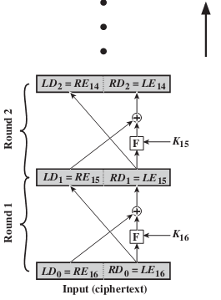
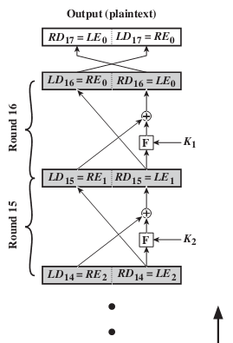
Cont . . .
Feistel Decryption (16 rounds)

Slide 13
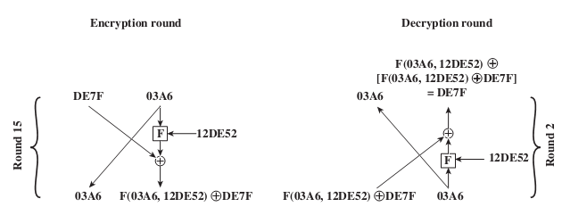
Cont . . .
Example of FCS
To help clarify the preceding concepts, let us look at a specific example and focus on the 15th round of encryption, corresponding to the second round of decryption

Slide 14

Cont . . .
Suppose that the blocks at each stage are 32 bits (two 16-bit halves) and that the key size is 24 bits.
Suppose that at the end of encryption round fourteen, the value of the intermediate block (in hexadecimal) is DE7F03A6.
Then LE₁₄ = DE7F and RE₁₄ = 03A6
Also assume that the value of is K₁₅ = 12DE52.
After round 15, we have

Slide 15
FCs design elements
The exact realization of a Feistel network depends on the choice of the following parameters and design features
    Block size
    Key size
    Number of rounds
    Subkey generation algorithm
    Round function
    Fast software en/decryption
    Ease of analysis

Slide 16
The DES Algorithm

Slide 17
The DES Cipher
DES is a block cipher, operating on blocks of 64 bits (8-16 characters, depending on encoding)
Key is any 56 bit value, generally expressed as a 64 bit number, with every 8th bit acting as a parity bit.
Encryption is accomplished by alternating substitutions and permutations, performed in a series of "rounds" where each round employs a different subkey derived from the original key.
Algorithm is based on the idea of a "Feistel Network", which provides a basis for generating mapping functions that are guaranteed to be invertible, and their own inverses.

Slide 18
Cont . . .
Basically, a bit string is split into two halves (L, R), some function f is applied to the right half to obtain f(R), and a new string (L XOR f(R), R) is produced.
Clearly, if this operation is applied twice, we get the original string back (L XOR f(R) XOR f(R), R) = (L, R).
DES employs a series of functions f1, f2 ... f16, and swaps the L and R halves after each application except the last one.
So (L, R) goes to (R, L XOR f(R)). This ensures that both left and right halves get mixed up.
The particular functions depend on the key.
Each such operation is called round, so DES uses 16 rounds.

Slide 19
Cont . . .
Algorithm
Step 1: The 64 bit plain text blocks are handed over to the initial permutation (IP) function.
Step 2: Perform an initial permutation (IP) of the plaintext, the block is broken into left and right halves (LPT, RPT) 32-bit each.
Step 3: Perform 16 rounds of encryption process each round with its own key.
For each of the 16 rounds
LPT_{i} = RPT_{i-1} and
RPT_{i} = LPT_{i -1} F (RPT_{i-1}, K_{i})
+

Slide 20

Cont . . .
Rounds are defined as follows in the algorithm:
Step 3a: Key transformation
Step 3b: Expansion Permutation (EP)
Step 3c: S-Box Substitution
Step 3d: P-Box Permutation
Step 3e: XOR (LPT and Output of step 3d)
Next Round ----> LPT_{i} = RPT_{i-1} and RPT_{i} = Output of step 3e
Step 4: The output of the final round (LPT and RPT) are Swapped and rejoined, then sent through a final permutation, which is the inverse of the initial permutation. This is final result of encrypting the block.
Step 5: The result of this process produces 64-bit cipher text.

Slide 21
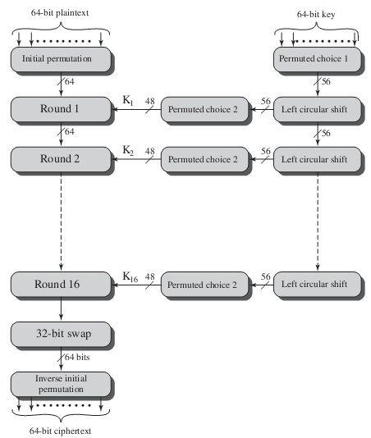
Cont . . .

Slide 22
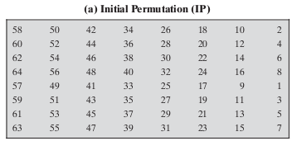
Cont . . .
Initial and Final Permutation
The initial permutation (IP) and its inverse (final permutation) IP⁻¹ rearranges bits according to the following table, where the entries in the table show the new arrangement of bits from their initial order.
They defined/presented as a table for ease of presentation as follow.

Slide 23
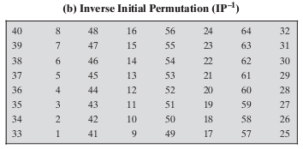
Cont . . .
Both the tables specifies the input permutation on a 64-bit block and interpreted in the same fashion .
Example meaning of IP table: the first bit of the output is taken from the 58th bit of the input; the second bit from the 50th bit, and so on, with the last bit of the output taken from the 7th bit of the input.
Aimed at optimizing early hardware implementations and they have no cryptography significance in DES

Slide 24
Cont . . .
Key Transformation
DES operates on the 64-bit blocks using key sizes of 56- bits.
The keys are actually stored as being 64 bits long, but every 8th bit in key is not used (i.e. bits numbered 8, 16, 24, 32, 40, 48, 56, 64).
The 64-bit key is permuted according to the following table, Permuted choice one (PC-1)
And this permutation performed only once at the beginning, before encryption round entered.
    Since the 1st entry in the table is "57", this means that the 57th bit of the original key K becomes first bit of the permuted key K+.
    The 49th bit of original key becomes second bit of permuted key. The 4th bit of the original key is the last bit of the permuted key.

Slide 25
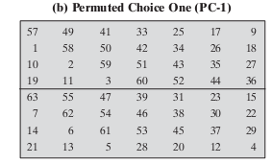
Cont . . .
Note only 56 bits of the original key appear in the permuted key.
Key Generation
The round-key generator creates sixteen 48-bit keys out of a 56-bit cipher key.

Slide 26
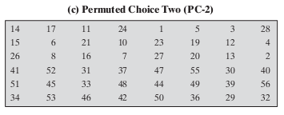

Cont . . .
The 56 key bits are shifted, in two halves, by one or two bits, and 48 bits selected by a "compression permutation“ called Permuted choice two (PC-2), to form a sub-key for the round.
The process of key generation is depicted in the following illustration

Slide 27
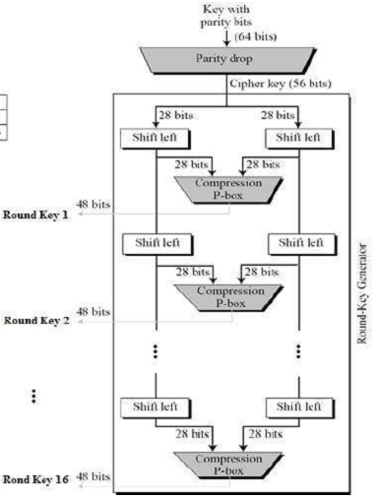
Cont . . .

Slide 28
Cont . . .
Example of Key Transformation
From the original 64-bit key
K = 00010011 00110100 01010111 01111001 10011011 10111100 11011111 11110001
We get the 56-bit permutation
K+ = 1111000 0110011 0010101 0101111 0101010 1011001 1001111 0001111
Next, split this key into left and right halves, C₀ and D₀, where each half has 28 bits. So that from the permuted key K+, we get
C₀ = 1111000 0110011 0010101 0101111
D₀ = 0101010 1011001 1001111 0001111
With C₀ and D₀ defined, we now create sixteen blocks C_{n} and D_{n}, 1<=n<=16. Each pair of blocks C_{n} and D_{n} is formed from the previous pair C_{n-1} and D_{n-1}, respectively, for n = 1, 2, ..., 16, through "left shifts" of the previous block according shift schedule.

Slide 29
Cont . . .
This means, for example, C₃ and D₃ are obtained from C₂ and D₂, respectively, by two left shifts, and C₁₆ and D₁₆ are obtained from C₁₅ and D₁₅, respectively, by one left shift.
In all cases, by a single left shift is meant a rotation of the bits one place to the left, so that after one left shift the bits in the 28 positions are the bits that were previously in positions 2, 3,..., 28, 1.
So that from original pair C₀ and D₀ we obtain:
    C₀ = 1111000011001100101010101111
    D₀ = 0101010101100110011110001111
    C₁ = 1110000110011001010101011111
    D₁ = 1010101011001100111100011110
    C₂ = 1100001100110010101010111111
    D₂ = 0101010110011001111000111101
Note:
Similarly Compute for the others also

Slide 30
Cont . . .
We now form the keys K_{n}, for 1<=n<=16, by applying the permutation using PC-2 table to each of concatenated pairs C_{n}D_{n}.
Each pair has 56 bits, but PC-2 only uses 48 of these.
Accordingly for the first key we have
C₁D₁ = 1110000 1100110 0101010 1011111 1010101 0110011 0011110 0011110
Which, after we apply the permutation PC-2, becomes
K₁ = 000110 110000 001011 101111 111111 000111 000001110010
For the other keys (K_{2,} K_{3,} K₄) we have
K₂ = 011110 011010 111011 011001 110110 111100 100111 100101
K₃ = 010101 011111 110010 001010 010000 101100 111110 011001
K₄ = 011100 101010 110111 010110 110110 110011 010100 011101
Note: Similarly Compute for the others also

Slide 31
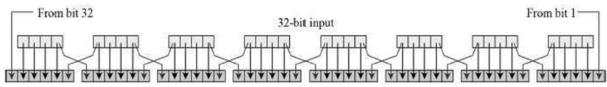
Cont . . .
Expansion Permutation (EP)
Since right input is 32-bit and round key is a 48-bit, we first need to expand right input to 48 bits using an "expansion permutation”.
First the 32-bit text is divided into 8 blocks of 4 bits each.
Then by adding 2 bits extra, that is the first bit of the block 1 is the last bit of the block 8 and the last bit of the block 8 is the first bit of the 7th block the 48-bit text is obtained.
Permutation logic is graphically depicted in the

Slide 32
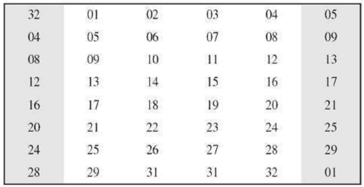
Cont . . .
The graphically depicted permutation logic is generally described as table in DES specification as follow.
Example: We calculate E(R₀) from R₀ as follows:
R₀ = 1111 0000 1010 1010 1111 0000 1010 1010
E(R₀) = 011110 100001 010101 010101 011110 100001 010101 010101

Slide 33
Cont . . .
After the expansion permutation, DES does XOR operation on the expanded right section and the round key. The round key is used only in this operation.
Example: For K₁ , E(R₀), we have
K₁ = 000110 110000 001011 101111 111111 000111 000001 110010
E(R₀) = 011110 100001 010101 010101 011110 100001 010101 010101
K₁+E(R₀) = 011000 010001 011110 111010 100001 100110 010100 100111.

Slide 34
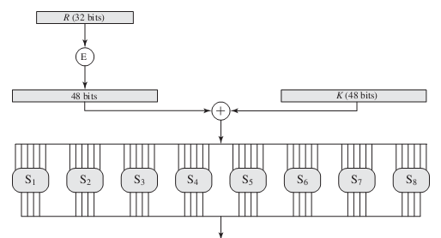
Cont . . .
S-Box Substitution
The result of Expansion permutation which XORed with Key is sent through a set of 8 fixed "S-boxes”
The S-boxes carry out the real mixing confusion.

Slide 35
Cont . . .
DES uses 8 S-boxes, each with a 6-bit input and a 4-bit output
The output of all eight s-boxes is then combined in to 32 bit section.
How it works
  The 48-bit blocks of S-box input divided into 8 blocks of 6 bits each.
  Decimal equivalent of the first and last bit in a block denotes the row number and decimal equivalent of the bit 2,3,4 and 5 denotes the column number of the S-Box Substitution table.
  Check the value and take the binary equivalent of the number.
  The result is 4-bit binary number
Write the previous result, which is 48 bits, in the form:
K_{n} + E(R_{n-1}) = B₁B₂B₃B₄B₅B₆B₇B₈,where B_{i} is a group of six bits.
We now calculate:- S₁(B₁)S₂(B₂)S₃(B₃)S₄(B₄)S₅(B₅)S₆(B₆)S₇(B₇)S₈(B₈) where S_{i}(B_{i}) refers to the output of the i-th S box.

Slide 36
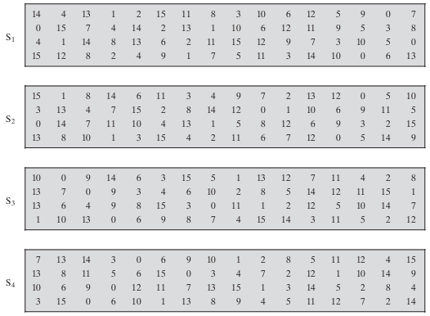
Cont . . .
Tables defining the functions S₁,...,S₄

Slide 37
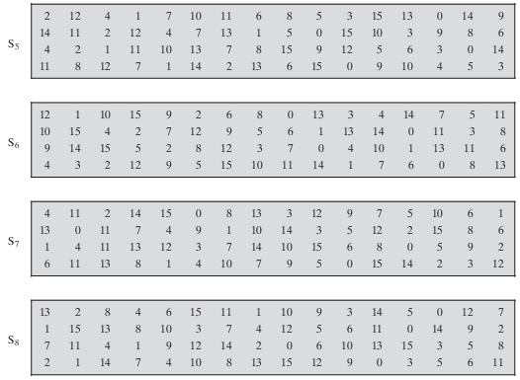
Cont . . .
Tables defining the functions S₅,...,S₈

Slide 38
Cont . . .
If S₁ is the S-box function table and B is a block of 6 bits, then S₁(B) is determined as follows:
  The first and last bits of B represent in base 2, a number in the decimal range 0 to 3 (or binary 00 to 11). Let that number be i.
  The middle 4 bits of B represent in base 2 a number in the decimal range 0 to 15 (binary 0000 to 1111). Let that number be j.
  Look up in the table the number in the i-th row and j-th column. It is a number in the range 0 to 15 and is uniquely represented by a 4 bit block. That block is the output S₁(B) of S₁ for the input B.
E.g. 1) for input block B = 011011 first bit is "0" and last bit "1" giving 01 as row. This is row 1. The middle four bits are "1101". This is the binary equivalent of decimal 13, so the column is number 13. In row 1, column 13 appears 5. This determines the output; 5 is binary 0101, so that the output is 0101. Hence S₁(011011) = 0101.

Slide 39
Cont . . .
Example 2) if the 6-bit number is 100101,
  Then the first and last bit is 11 and the decimal equivalent of the number is 3.
  Remaining bits are 0010 and the decimal equivalent of the number is 2.
  If it is the first block of input, then check the 3rd row 2nd column value in the S-box-1 substitution table. It is given as 1 in the table. Binary equivalent of 1 is 0001.
  The input 100101 of 6-bit is now reduced to 0001 after S-Box Substitution.
Accordingly for the 1st round, we obtain as the output of the 8 S boxes
K₁ + E(R₀) = 011000 010001 011110 111010 100001 100110 010100 100111.
S₁(B₁)S₂(B₂)S₃(B₃)S₄(B₄)S₅(B₅)S₆(B₆)S₇(B₇)S₈(B₈) =
0101 1100 1000 0010 1011 0101 1001 0111

Slide 40
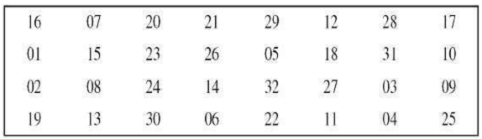
Cont . . .
P-Box Permutation
The 32 bit output of S-boxes is then subjected to the straight permutation with rule shown in the following illustration
The permutation P is yields a 32-bit output from a 32-bit input by involving simple permutation bits of the input block that is replacement of each bit with another bit as specified in the p-Box table, without any expansion or compression.

Slide 41
Cont . . .
Example: From the output of the eight S boxes:
S₁(B₁)S₂(B₂)S₃(B₃)S₄(B₄)S₅(B₅)S₆(B₆)S₇(B₇)S₈(B₈) =
0101 1100 1000 0010 1011 0101 1001 0111
we get f = 0010 0011 0100 1010 1010 1001 1011 1011
XOR and Swap
The untouched LPT, which is of 32 bits, is XORed with the resultant RPT that is with the output produced by P-Box permutation.
The result of this XOR operation becomes the new right half.
The old right half becomes the new left half in the process of swapping.
At end of 16 rounds, the Final Permutation is performed only once.
This is a simple transposition based on the Final Permutation Table.
Output of the Final permutation is the 64-bit encrypted block

Slide 42
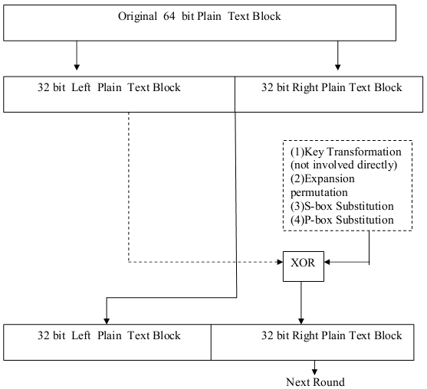
Cont . . .

Slide 43
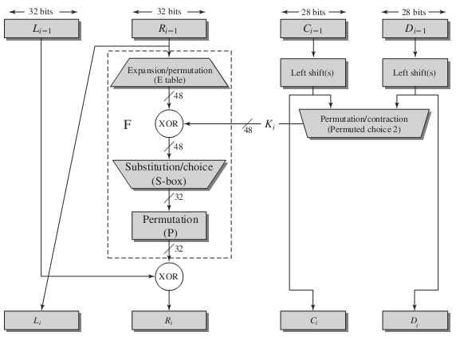
Cont . . .
Single Round of DES Algorithm

Slide 44
Cont . . .
Exercise
Let M be the plain text message M = 0123456789ABCDEF, where M is in hexadecimal (base 16) format. Rewriting M in binary format, we get the 64-bit block of text:
Let Key be the hexadecimal key K = 133457799BBCDFF1.
Just setting 1 = 0001, 2 = 0010, 3 = 0011, etc., and grouping together every bits, the equivalent binary representation of M and K are:
M = 0000 0001 0010 0011 0100 0101 0110 0111 1000 1001 1010 1011 1100 1101 1110 1111
K = 00010011 00110100 01010111 01111001 10011011 10111100 11011111 11110001
What is the output ciphertext of DES of given plaintext M?

Slide 45
DES Analysis
The DES satisfies both the desired properties of block cipher which make cipher very strong.
Avalanche effect
  A desirable property of any encryption algorithm is that a small change in either the plaintext or the key should produce a significant change in the ciphertext.
  In particular, a change in one bit of the plaintext or one bit of the key should produce a change in many bits of the ciphertext. This is referred to as the avalanche effect.
  If the change were small, this might provide a way to reduce the size of the plaintext or key space to be searched
Completeness: Each bit of ciphertext depends on many bits of plaintext

Slide 46
DES Strength (what makes DES strong?)
The Use of 56-Bit Keys
  With a key length of 56 bits, there are 2⁵⁶ possible keys, which is approximately 7.2 x 10¹⁶ keys. Thus, on the face of it, a brute-force attack appears impractical.
  Assuming that, on average, half key space has to be searched, a single machine performing one DES encryption per microsecond would take more than a thousand years to break the cipher.
  Challenges: parallel machine and key-search attack
  But DES finally and definitively proved insecure in July 1998, when the Electronic Frontier Foundation (EFF) announced that it had broken a DES encryption using a special-purpose “DES cracker” machine that was built for less than $250,000.

Slide 47
Cont . . .
The Nature of the DES Algorithm
    Because the design criteria for S-boxes, and indeed for entire algorithm, weren’t made public, there is suspicion that S-boxes were constructed in such a way that cryptanalysis is possible for an opponent who knows the weaknesses in the S-boxes.
Timing Attacks
    Information about the key or plaintext is obtained by observing how long it takes given implementation to perform decryptions on various ciphertexts.
    It exploits the fact that an en/decryption algorithm often takes slightly different amounts of time on different inputs.
    DES appears to be fairly resistant to a successful timing attack

Slide 48
Multiple Encryption with DES
You can improve the security of DES by performing multiple encryptions, known as super encryption.
The two most common ways of doing this are with double encryption (Double DES) and with triple encryption (Triple DES).
(1) Double DES
Each 64-bit block of data is encrypted twice with the DES algorithm, first with one key, then with another, as follows:
        1. Encrypt with (key 1).
        2. Encrypt with (key 2).
Plaintext (key1) (key2) ciphertext:

Slide 49
Cont . . .
Problem with Double DES
(1) Issue of reduction to single stage
  Suppose it were true for DES, for all 56-bit key values, that given any two keys K₁ and K₂ , it would be possible to find a key such that E(K₂ , E( K₁ , P)) = E(K₃ , P)
  If this were the case, then double encryption, and indeed any number of stages of multiple encryption with DES, would be useless because the result would be equivalent to a single encryption with a single 56-bit key.
  Reasonably, if DES is used twice with different keys, it will produce one of the many mappings that are not defined by a single application of DES

Slide 50
Cont . . .
  (2) Meet-in-the-middle attack
  Does not depend on any particular property of DES but that will work against any block encryption cipher.
  A known plaintext attack which requires that an attacker have both a known piece of plaintext and a block of that same text that has been encrypted
  Since X = E_{K1}(P) = D_{K2}(C)
  Given known pair, (P, C), attack proceeds as follows. First, encrypt for all possible values of 2⁵⁶. Store these results in a table and then sort the table by the values of X. Next, decrypt using all possible values of 2⁵⁶. As each decryption is produced, check the result against the table for a match. If a match occurs, then test the two resulting keys against a new known plaintext–ciphertext pair. If the two keys produce correct ciphertext, accept them as correct keys.

Slide 51

Cont . . .
(2) Triple DES with Two Keys
It is just a DES with two 56-bit keys applied.
Given plaintext, 1st key is used to DES- encrypt the message.
2nd key is used to DES-decrypt the encrypted message. (Since 2nd key is not right key, this decryption just scrambles the data further.)
The twice-scrambled message is then encrypted again with the first key to yield the final ciphertext.
(3) Triple DES with Three Keys
Triple-DES can also done with 3 separate keys instead of only two
Three-key 3DES has an effective key length of 168 bits and is defined as

Slide 52
DES Crypto Analysis
Given a set of known plaintexts and crypto texts, it is possible to analyze the pairs and construct and reduce the number of keys it is necessary to check.
Examples of such an approach are:
1. Differential crypto-analysis
    The rationale behind differential cryptanalysis is to observe the behavior of pairs of text blocks evolving along each round of the cipher, instead of observing evolution of a single text block
2. Linear crypto-analysis
    This attack is based on finding linear approximations to describe the transformations performed in DES.

Slide 53
DES Design Criteria
7 criteria for S-boxes provide for
  non-linearity
  resistance to differential cryptanalysis
  good confusion
3 criteria for permutation P provide for
  increased diffusion
Reading Assignment
Cryptography and Network Security Principles and Practice 5th Edition --- Page 92 - 96

Slide 54
The IDEA Algorithm
Reading Assignment

Slide 55
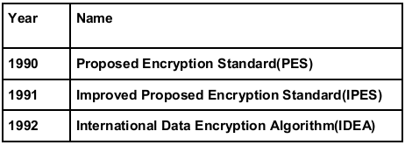
I DEA Algorithm and Its Working
The IDEA in perceived as one of the strongest cryptographic algorithms. It was launched in 1990 and underwent certain changes in names and capabilities as shown in table.
One popular email privacy technology known as Pretty Good Privacy (PGP) is based on IDEA.
It is block cipher which is reversible like DES, i.e. the same algorithm is used for encryption and decryption.
It uses both confusion and diffusion for encryption.

Slide 56
Cont . . .
Algorithm:
Step 1) Consider the input plain text of 64 bits.
Step 2) Divide the input plain text into 4 portions each of size 16 bits (Say P₁ to P₄).
Step 3) Now perform 8 rounds of algorithm.
(a) In each round 6 sub-keys are generated from the original key. Each of the sub-keys consists of 16-bits. These six sub-keys are applied to four input blocks P₁ to P₄.Thus for first round, we have 6 keys say k₁ to k6;for second round , we have k₇ to k₁₂.Finally for eight round we have keys k₄₃ to k₄₈.
(b) Multiply, add and XOR the plain text blocks with sub keys.
Step 4) Perform an output transformation in sub-keys.
Step 5) Combine all 4 blocks of output transformation to get cipertext

Slide 57
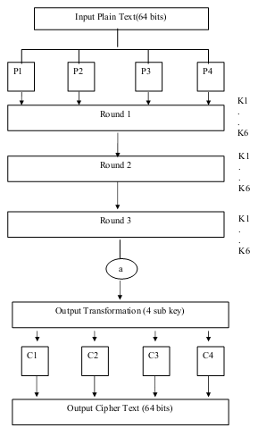
Cont . . .

Slide 58
Cont . . .
Details of first round in IDEA
  The initial key consists of 128 bits from which 6 sub-keys k1 to k6 are generated for the first round.
  Since k1 to k6 consist of 16 bits each, out of the original 128 bits, the first 96 bits(6 * 16 bits per sub–key) are used for first round.
  Thus at end of 1st round, bits 97-128 of original keys are unused.
Details of second round in IDEA
  In 2nd round 31 unused bits are used. For 2nd round we still require(96-31=65) more bits. But the original key 128 bits are exhausted.
  Now IDEA uses the techniques of key shifting and original key is shifted left circularly by 25 bits.

Slide 59
Cont . . .
Details of One round in IDEA
    1) Multiply P1 and k1 2) Add P2 and K2
    3) Add P3 and k3 4) Multiply P4 and k4
    5) XOR the results of steps 1 and 3
    6) XOR the results of steps 2 and 4
    7) Multiply step 5 and k5 8) Add steps 6 and step 7
    9) Multiply the result of step 8 and k6
    10) Add steps 7 and 9
    11) XOR the results of steps 1 and 9
    12) XOR the results of steps 3 and 9
    13) XOR the results of steps 2 and 10
    14) XOR the results of steps 4 and 10

Slide 60
Cont . . .
Details of output transformation
(1)It is one time operation. It takes place at end of the 8th round
(2) It is 64 bit value divided into 4 sub-blocks (say R1 to R4 each consisting of 16 bits).
    Step 1: Multiply R1 and k49
    Step2: Add R2 and k50.
    Step3: Add r3 and k51
    Step4: Multiply r4 & k52

Slide 61
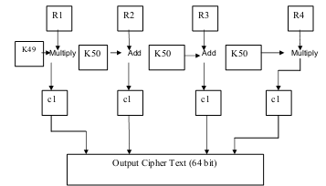
Cont . . .

Slide 62
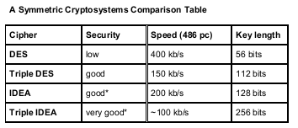
Cont . . .

Slide 63
THE END
???

